Slide 1
Component Architecture

Slide 2
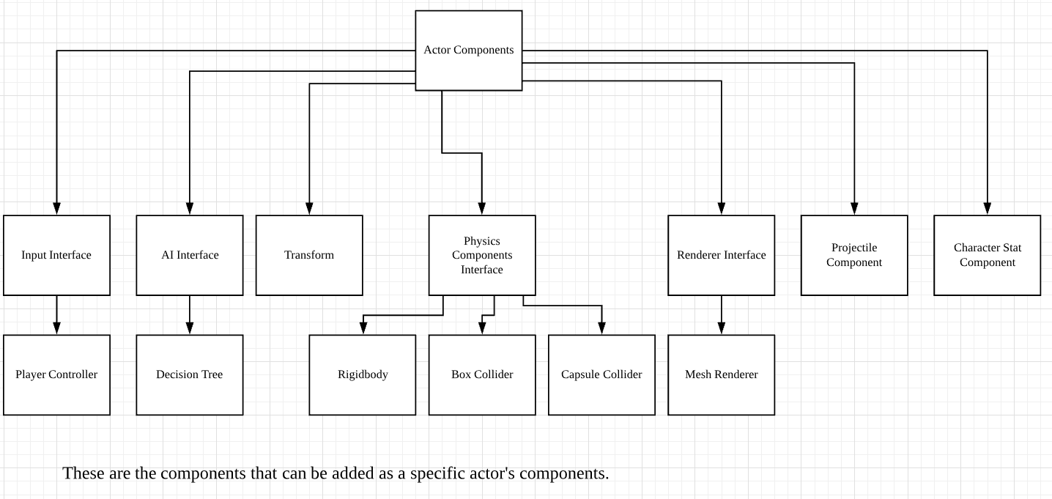
Component Diagram

Slide 3
Player Components
Player Components:
Player Controller
Transform
Rigidbody
Capsule Collider
Mesh Renderer
Character Stat Component

Slide 4
Enemy Components
Enemy Components:
Decision Tree
Transform
Rigidbody
Capsule Collider
Mesh Renderer
Character Stat Component

Slide 5
Projectile Components
Projectile Components
Transform
Rigidbody
Capsule Collider
Mesh Renderer
Projectile Component

Slide 6
Wall & Floor Components
Wall & Floor Components
Transform
Box Collider
Mesh Renderer

